Slide 1
Module V
Impact of Replenishment Policies in Safety Inventory: Role of Information Technology in inventory management, transportation in supply chain.
Topic of Discussion
Role of Information Technology (IT) in transportation in inventory management.

Slide 2
The impact technology in inventory systems
To minimize the overall total cost in inventory management.
To maximize the firms revenue or profitability.
To develop and implement effective systems in controlling inventory.
To promote global inventory control systems compatible with sustainability objectives of the organizations.
To supplement process changes with improved technology.
To use a forecasting system that support customer level forecasting.
To deploy supply chain visibility systems

Slide 3
Objective of application of IT in Inventory Management
Periodic of inventory
Selective inventory control such as ABC Analysis, XYZ analysis, VED analysis, FSN analysis
Inventory status reports and stores ledgers.
Exception reports of high/low stocks-( Bull whip effect)
Consumption analysis
Computation of EOQ

Slide 4
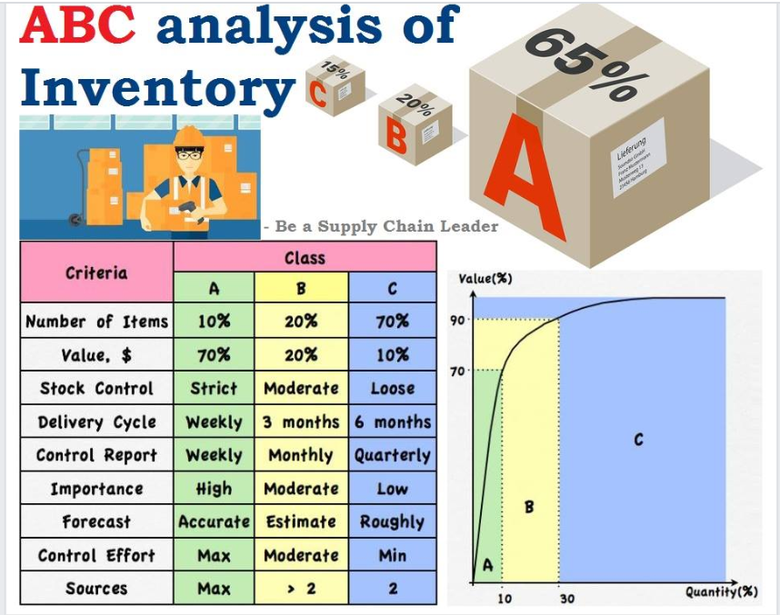
ABC analysis
ABC analysis is a type of inventory categorization method in which inventory is divided into three categories, A, B, and C, in descending value. A has the highest value items, B is lower value than A, and C has the lowest value.

Slide 5
#A items – 10% of the items accounts for 70% of the annual consumption value of the items. #B items - 20% of the items accounts for 20% of the annual consumption value of the items. #C items - 70% of the items accounts for 10% of the annual consumption value of the items.

Slide 6
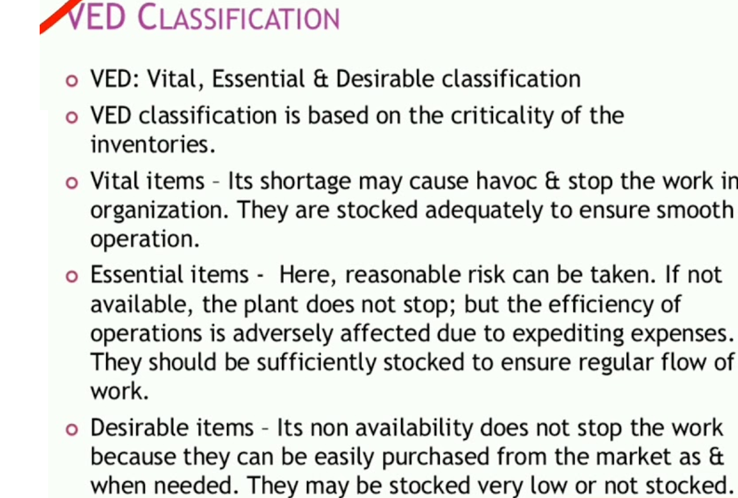
VED Analysis

Slide 7
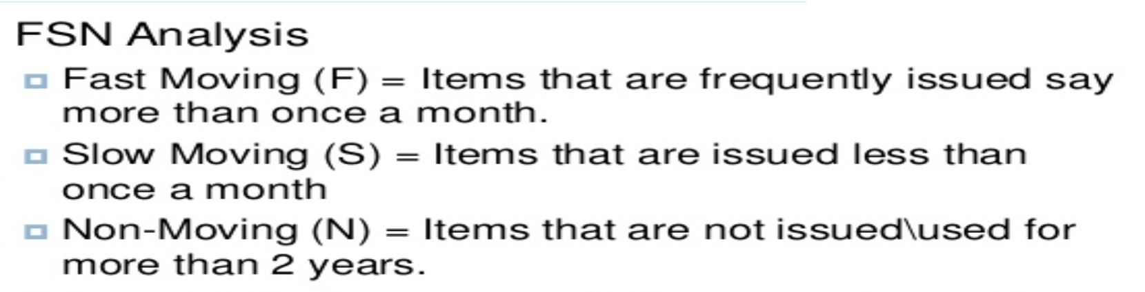

Slide 8
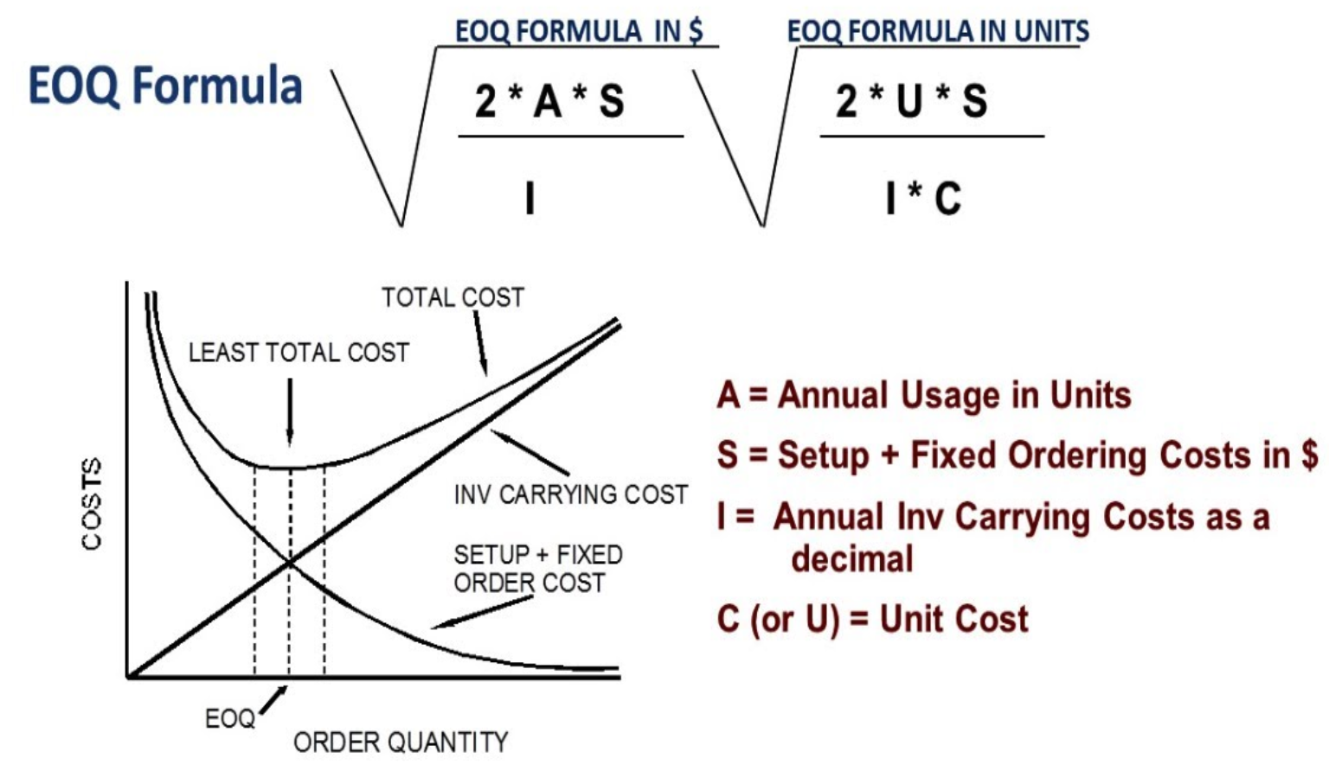
EOQ- Economic Ordering Quantity

Slide 9
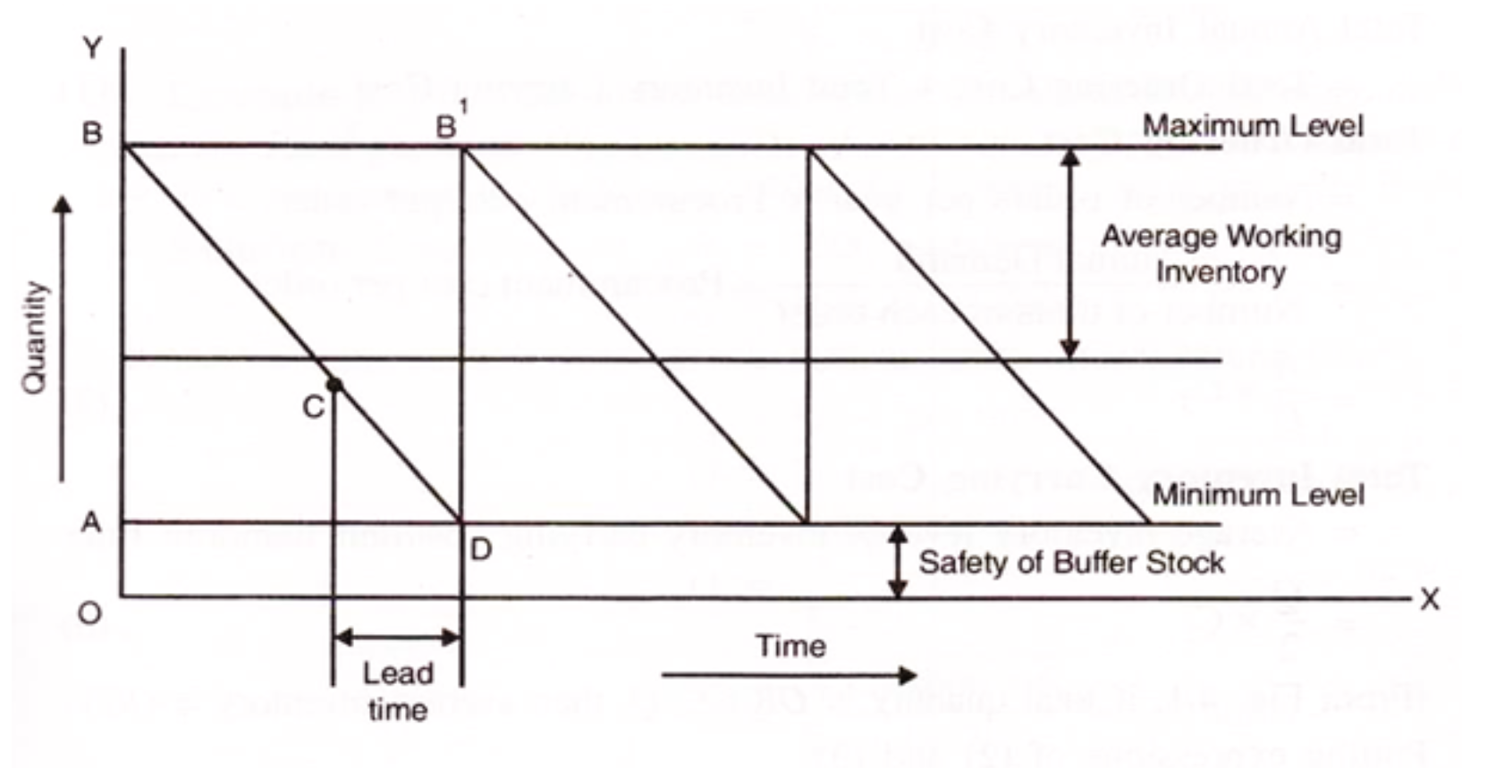

Slide 10
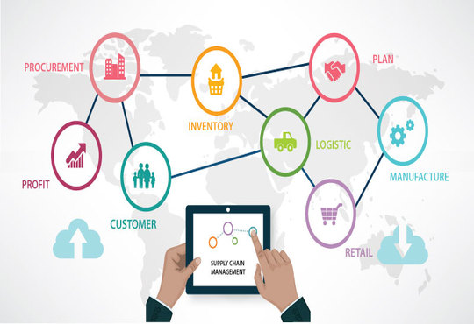

Slide 11
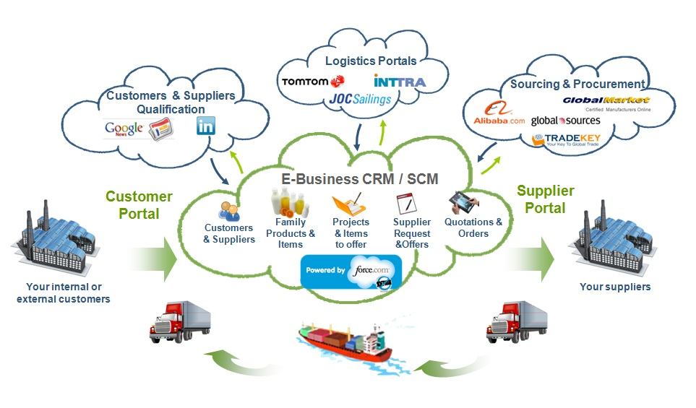

Slide 12
